Slide 2
OUT FOR LUNCH, WILL BE BACK AT 2:00 ☺

Slide 3
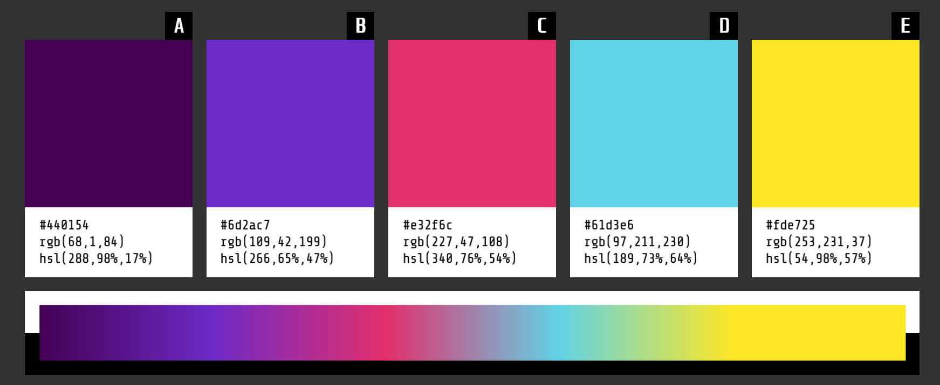
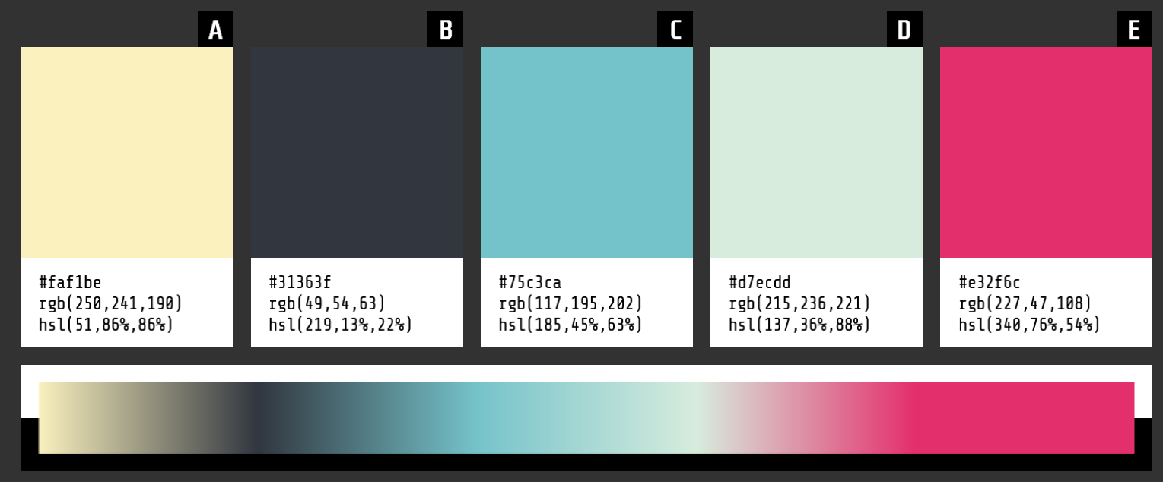

Slide 4
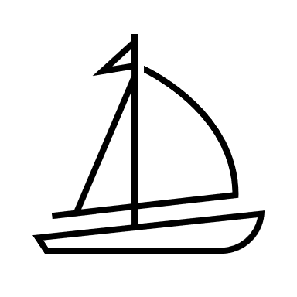
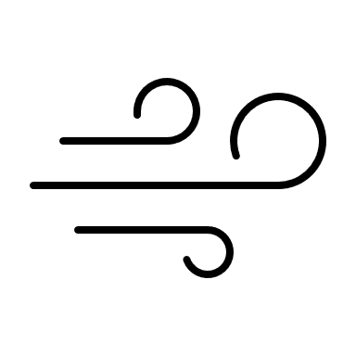
Mendelian
Editor (Wind)
Non-Mendelian
Edit (Sail)
12.5%
25%
Allele Frequency
12.5%
37.5%
12.5%
50%
Time

Slide 5
Mendelian
Editor (Wind)
Non-Mendelian
Edit (Sail)
12.5%
25%
12.5%
37.5%
Allele Frequency
12.5%
50%
Time

Slide 6
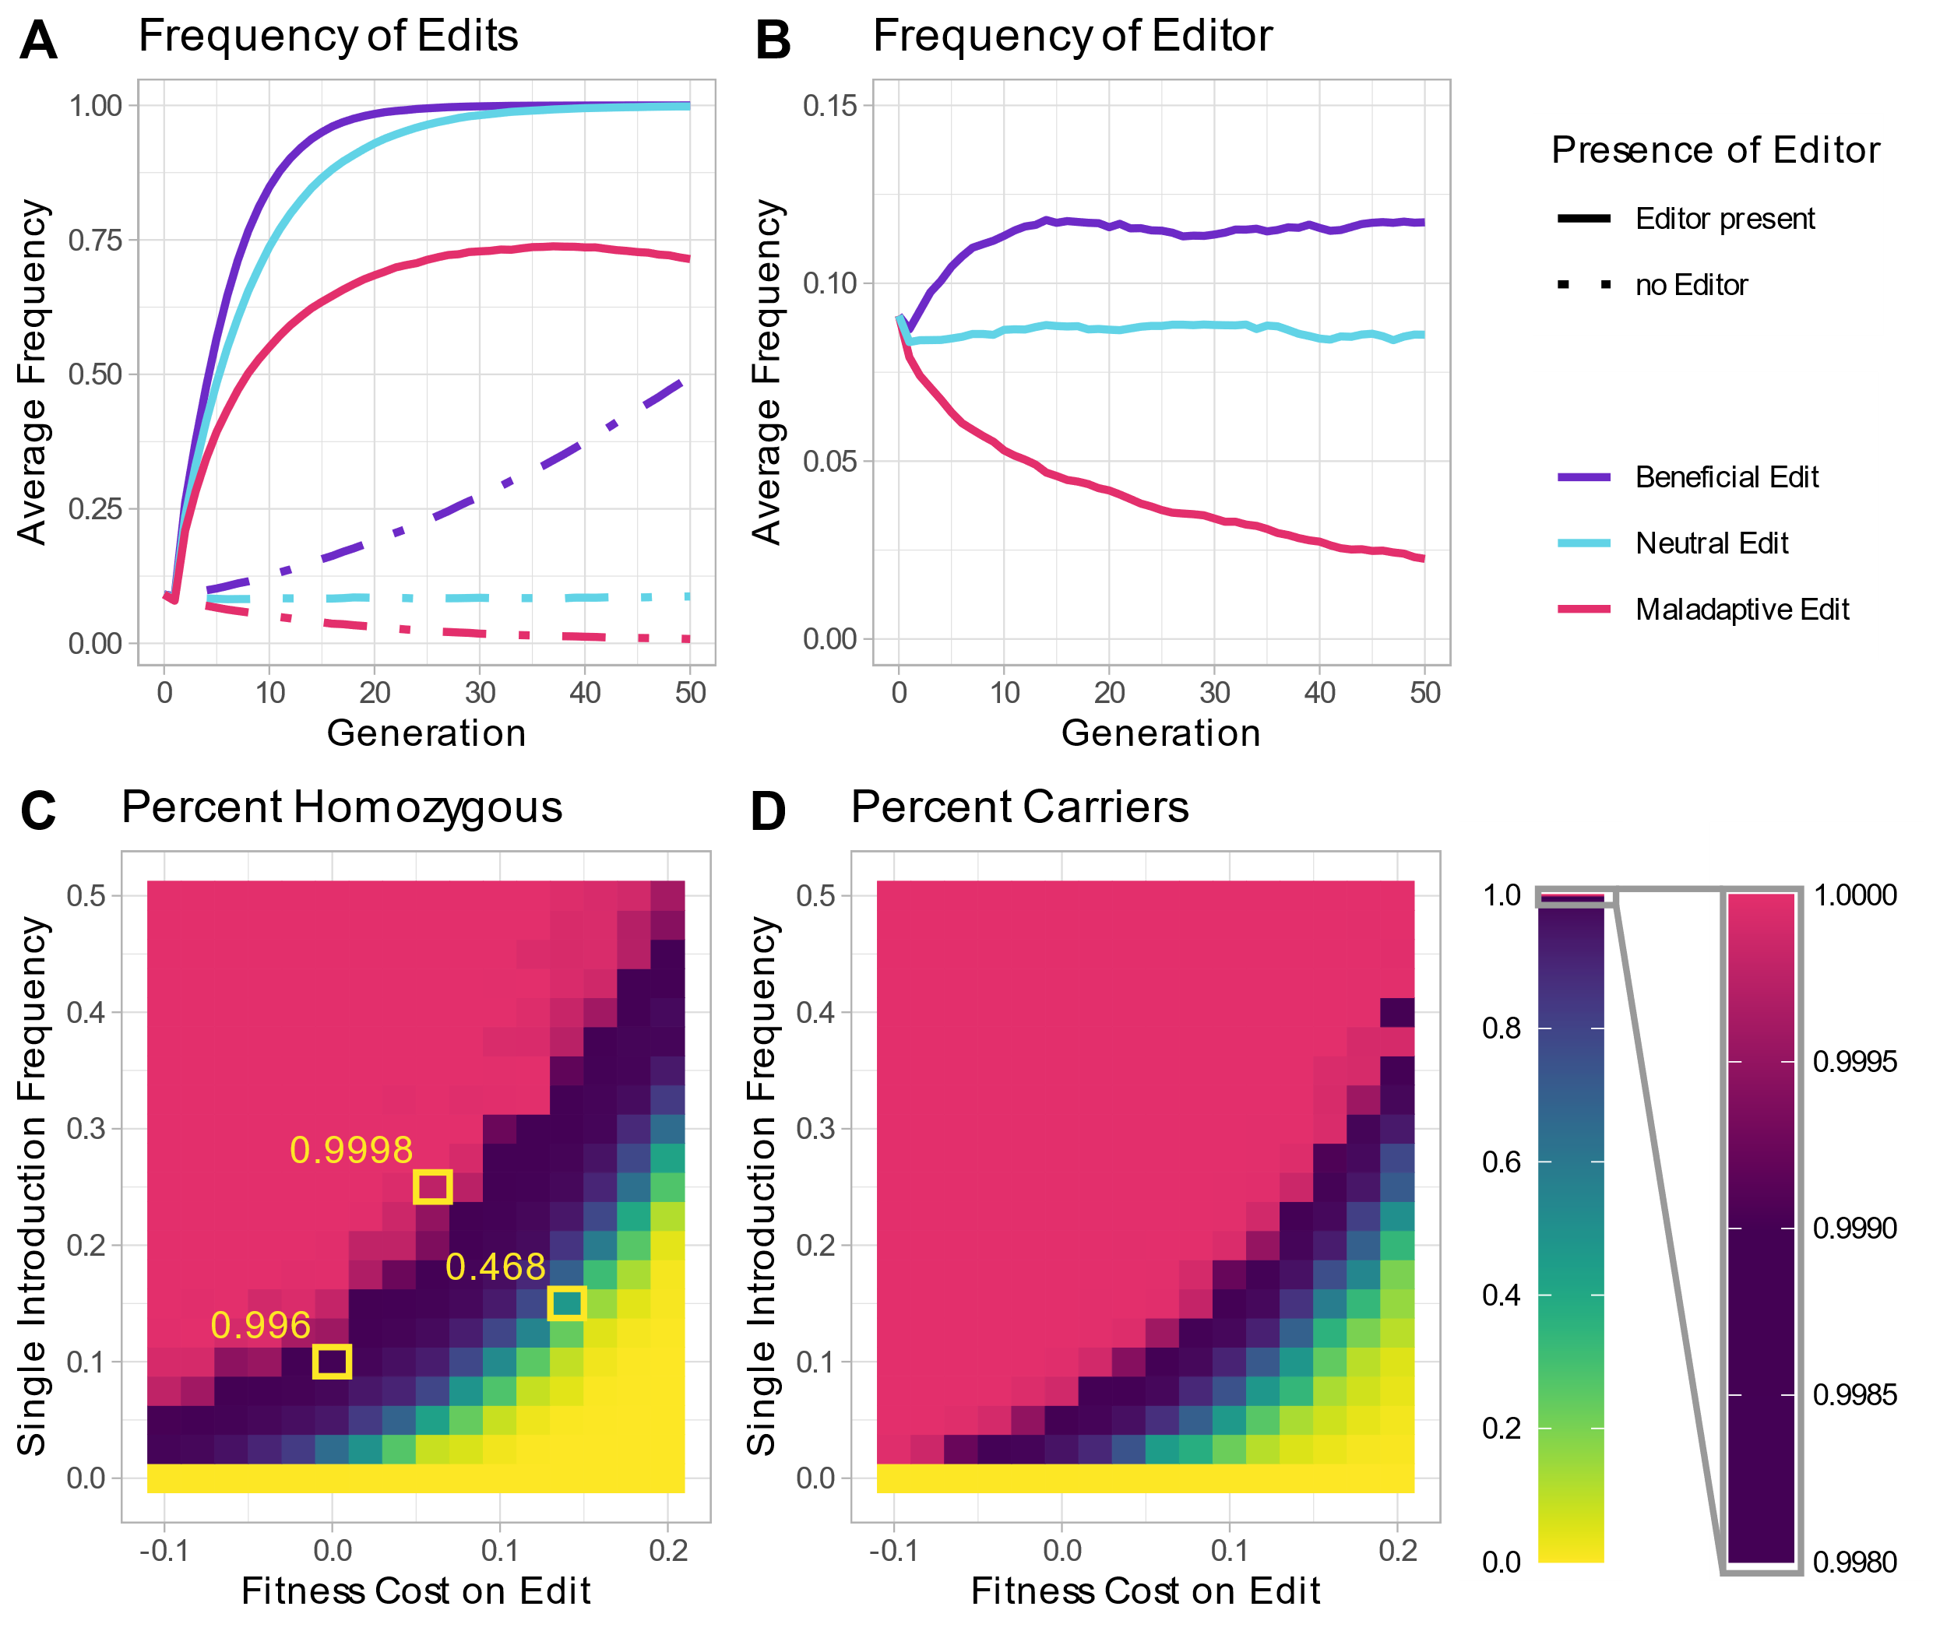

Slide 7
Mendelian
Editor (Wind)
Non-Mendelian
Edit (Sail)
12.5%
25%
Allele Frequency
12.5%
37.5%
12.5%
50%
Time

Slide 8
Mendelian
Driver (Wind)
Non-Mendelian
Edit (Sail)
12.5%
25%
Allele Frequency
12.5%
37.5%
12.5%
50%
Time

Slide 9


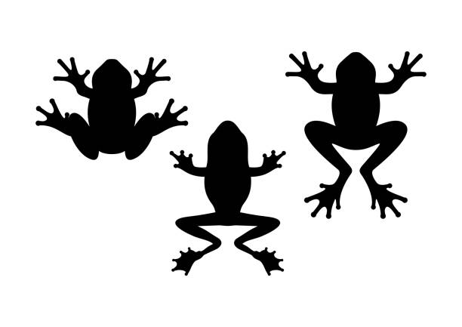

Slide 12
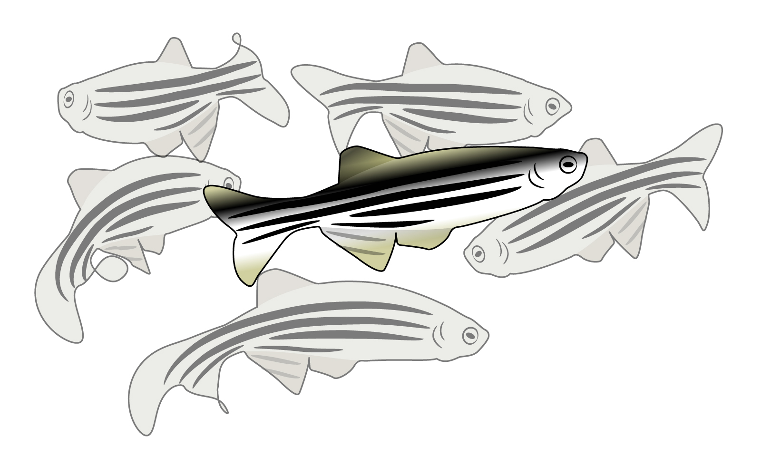
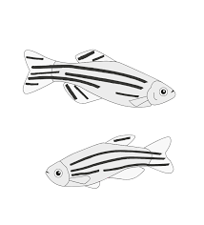

Slide 13
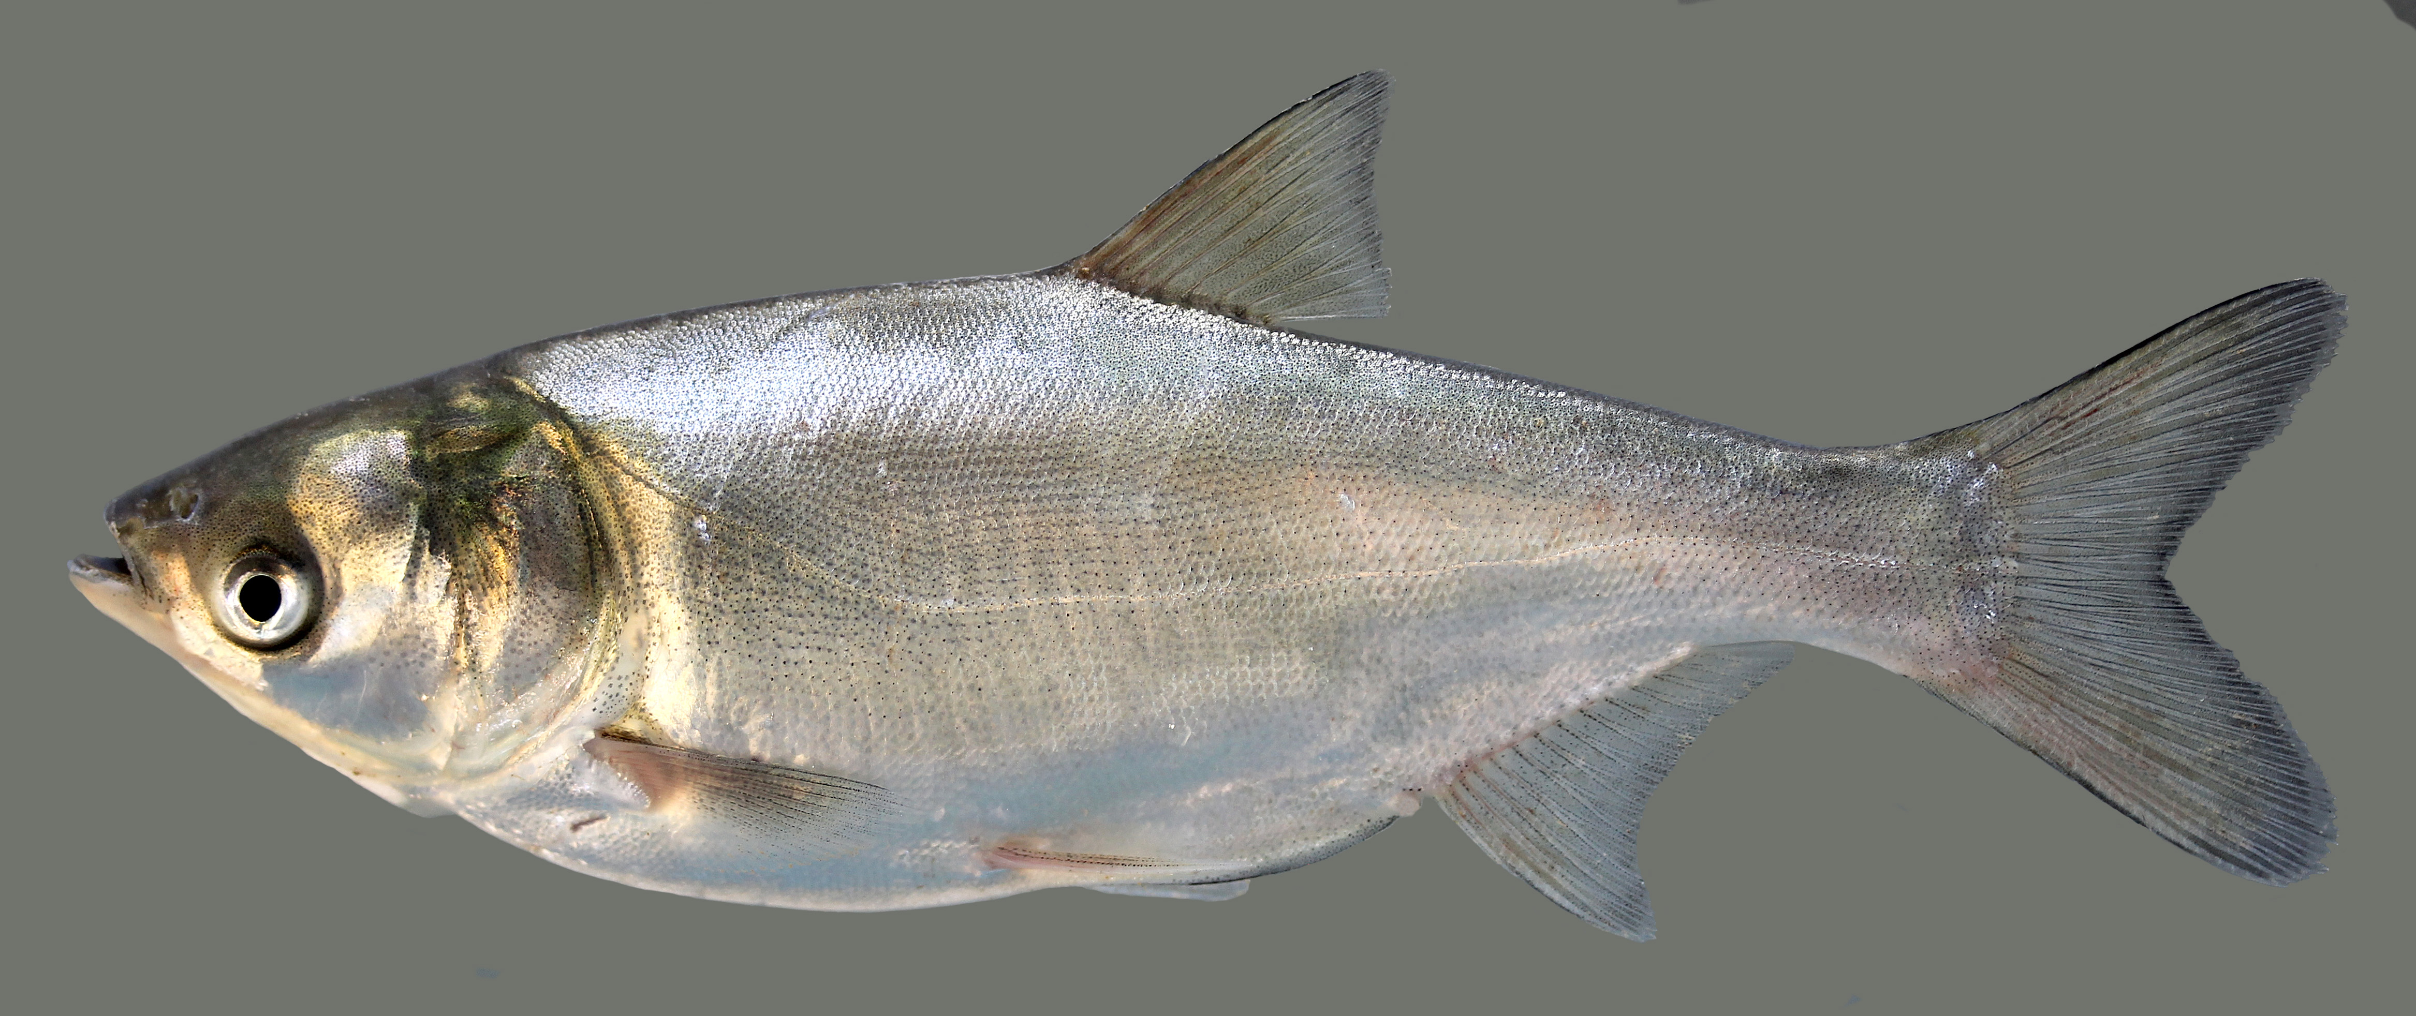

Slide 15
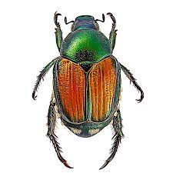

Slide 17
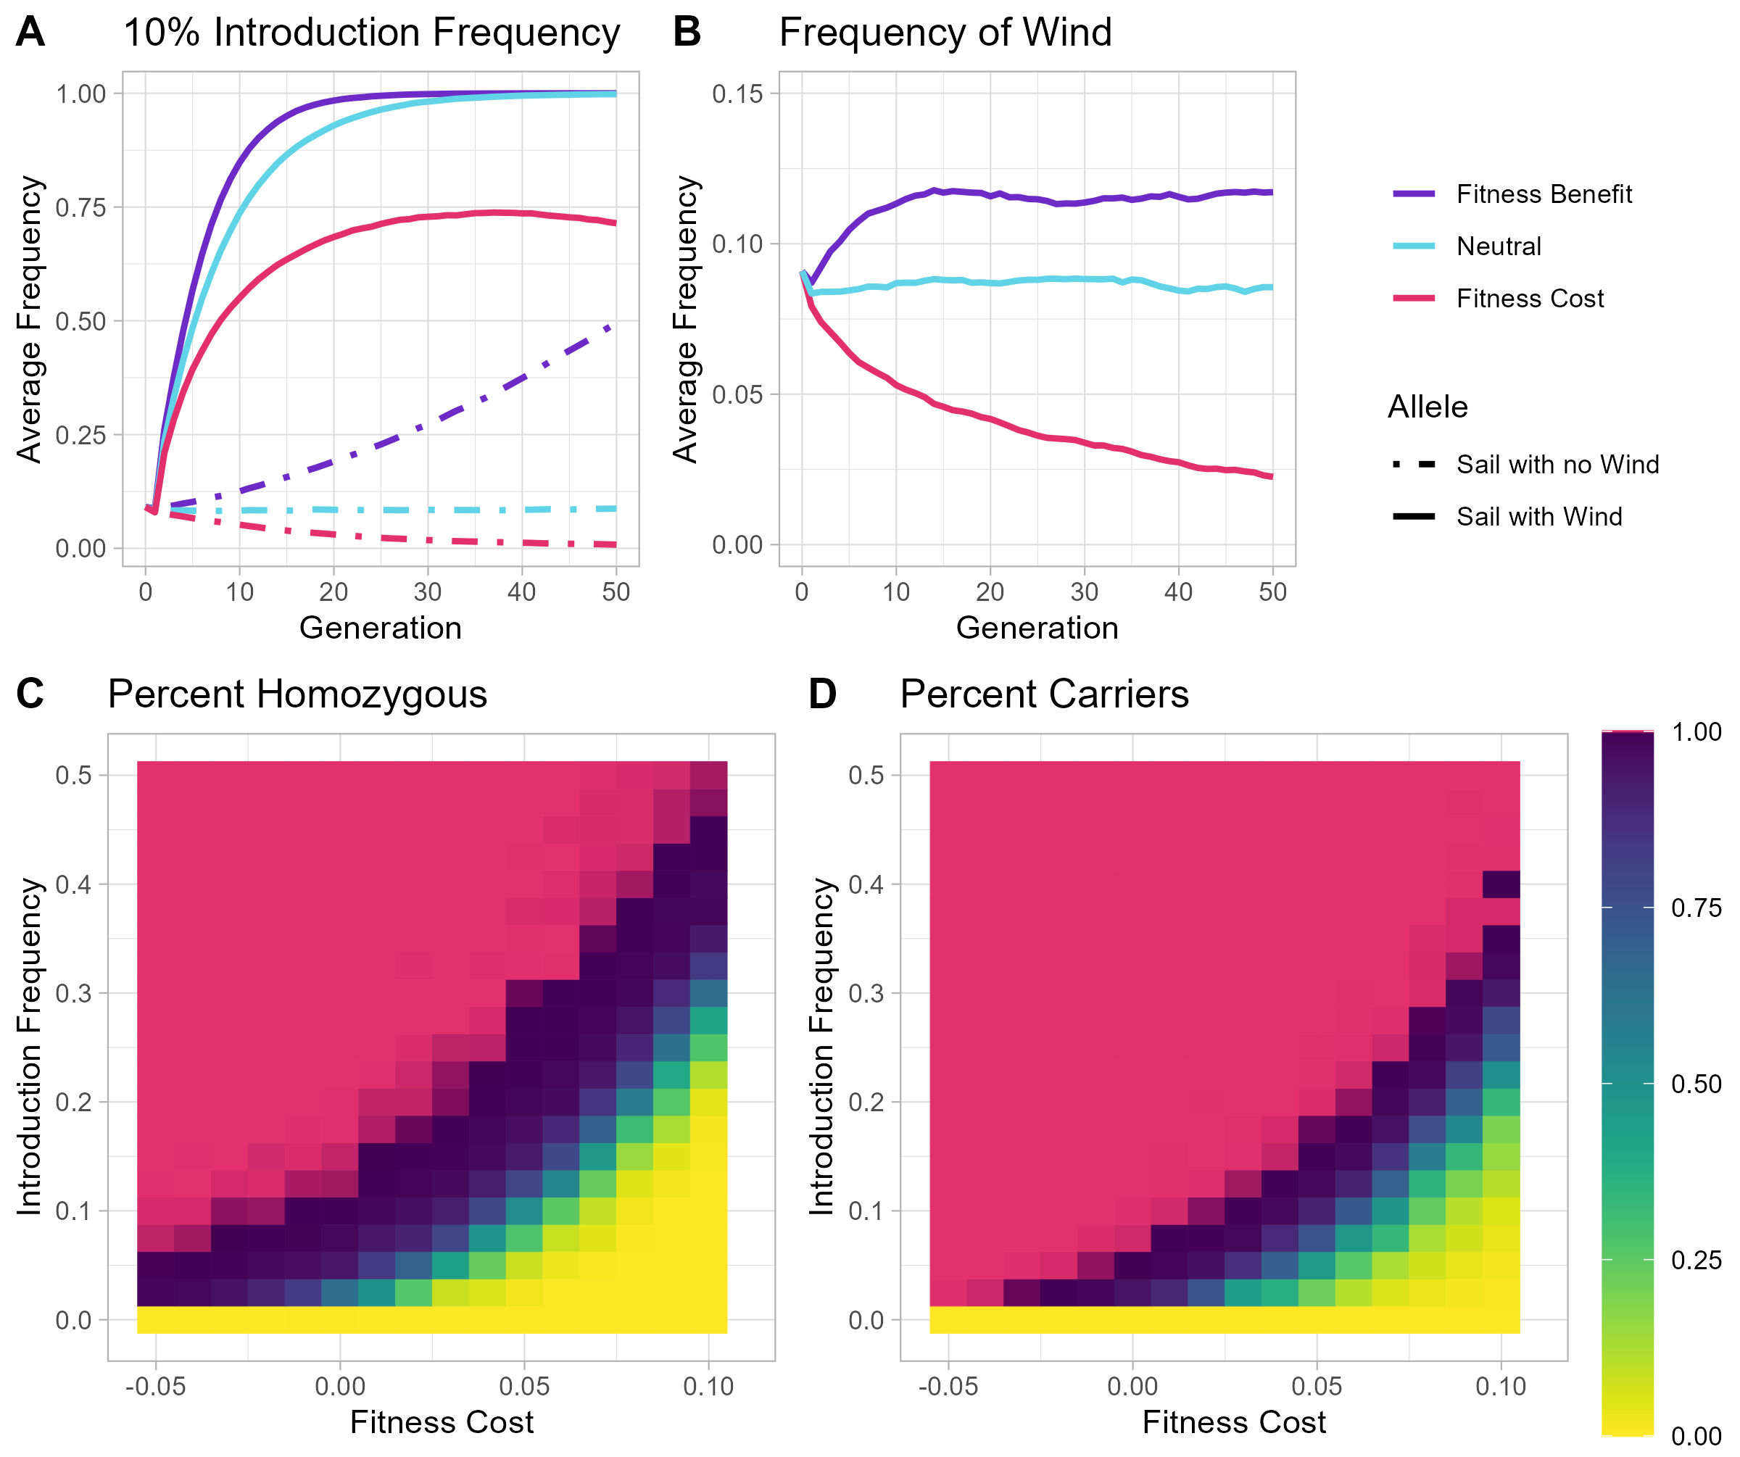
0.9992
0.996
0.467

Slide 18
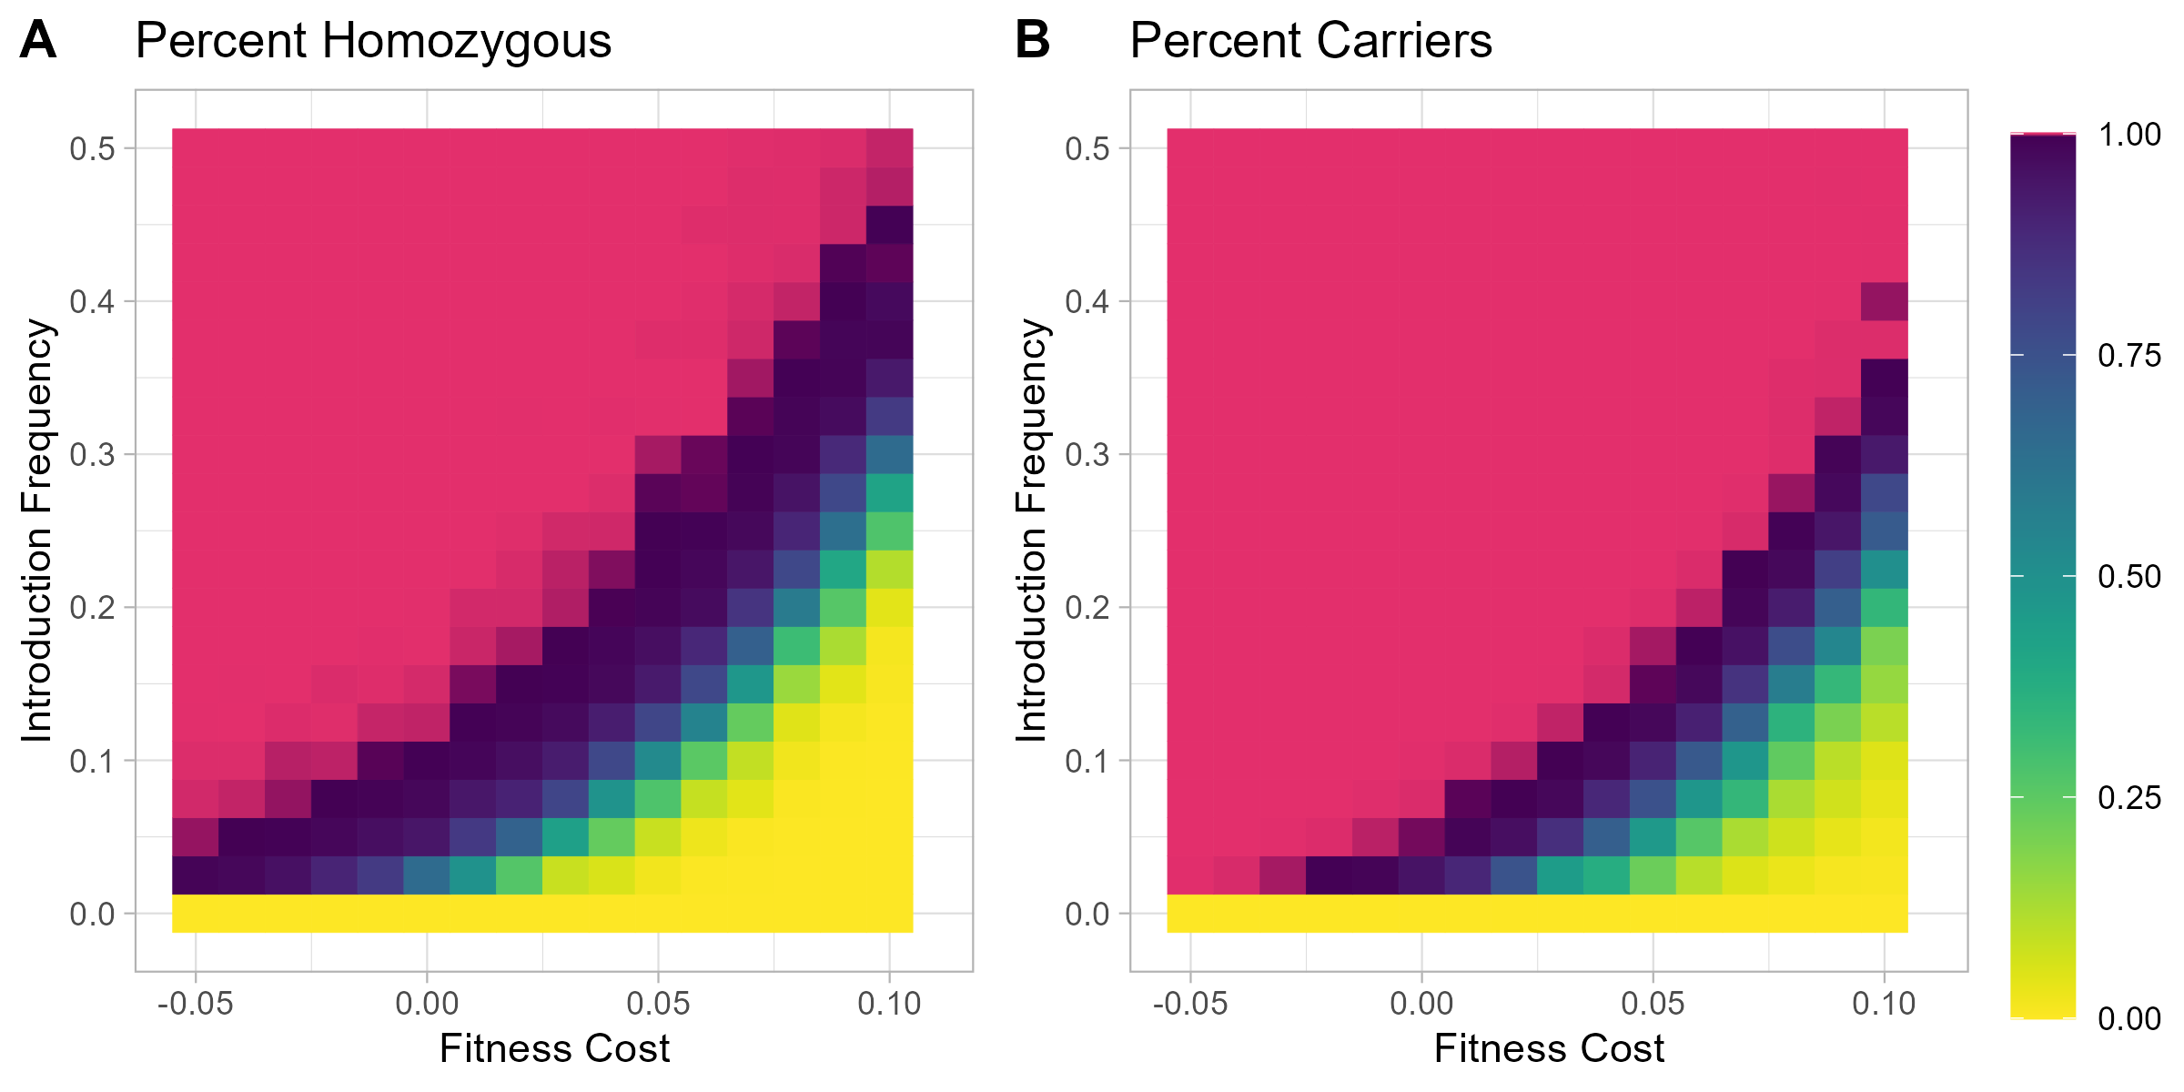
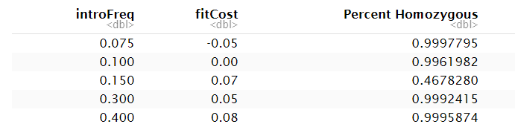
0.9992
0.996
0.467

Slide 19
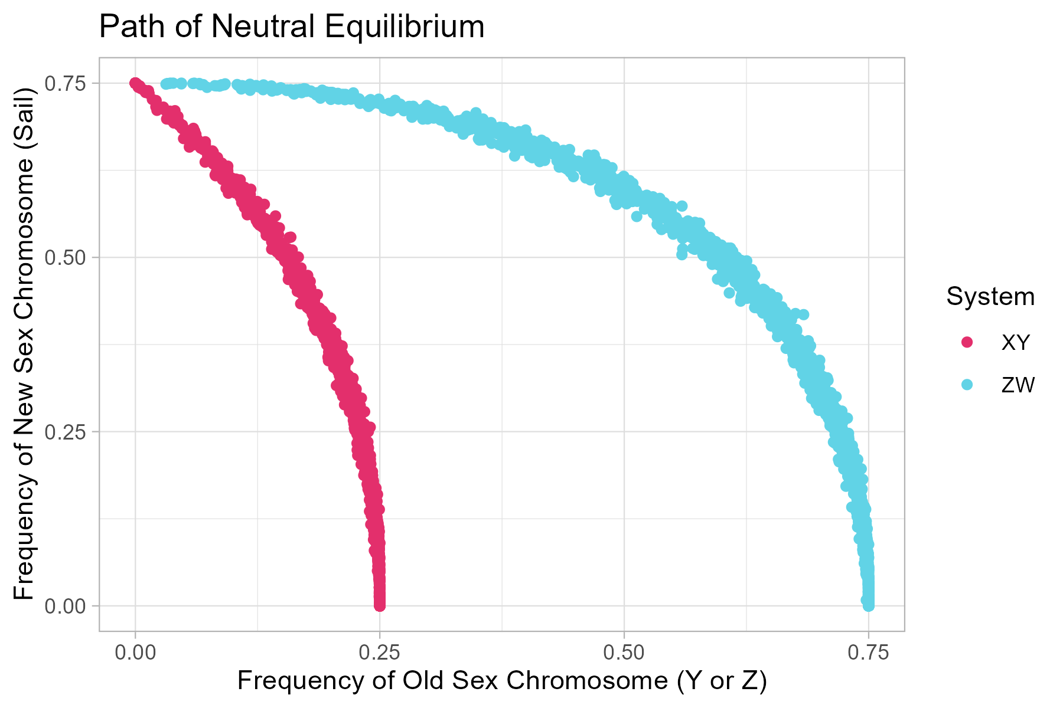
♂: WW Sail / Sail
♀: WW No Sail / No Sail
♂: XX Sail / Sail
♀: XX Sail / No Sail
♂: XY No Sail / No Sail
♀: XX No Sail / No Sail
♂: ZZ No Sail / No Sail
♀: ZW No Sail / No Sail

Slide 20
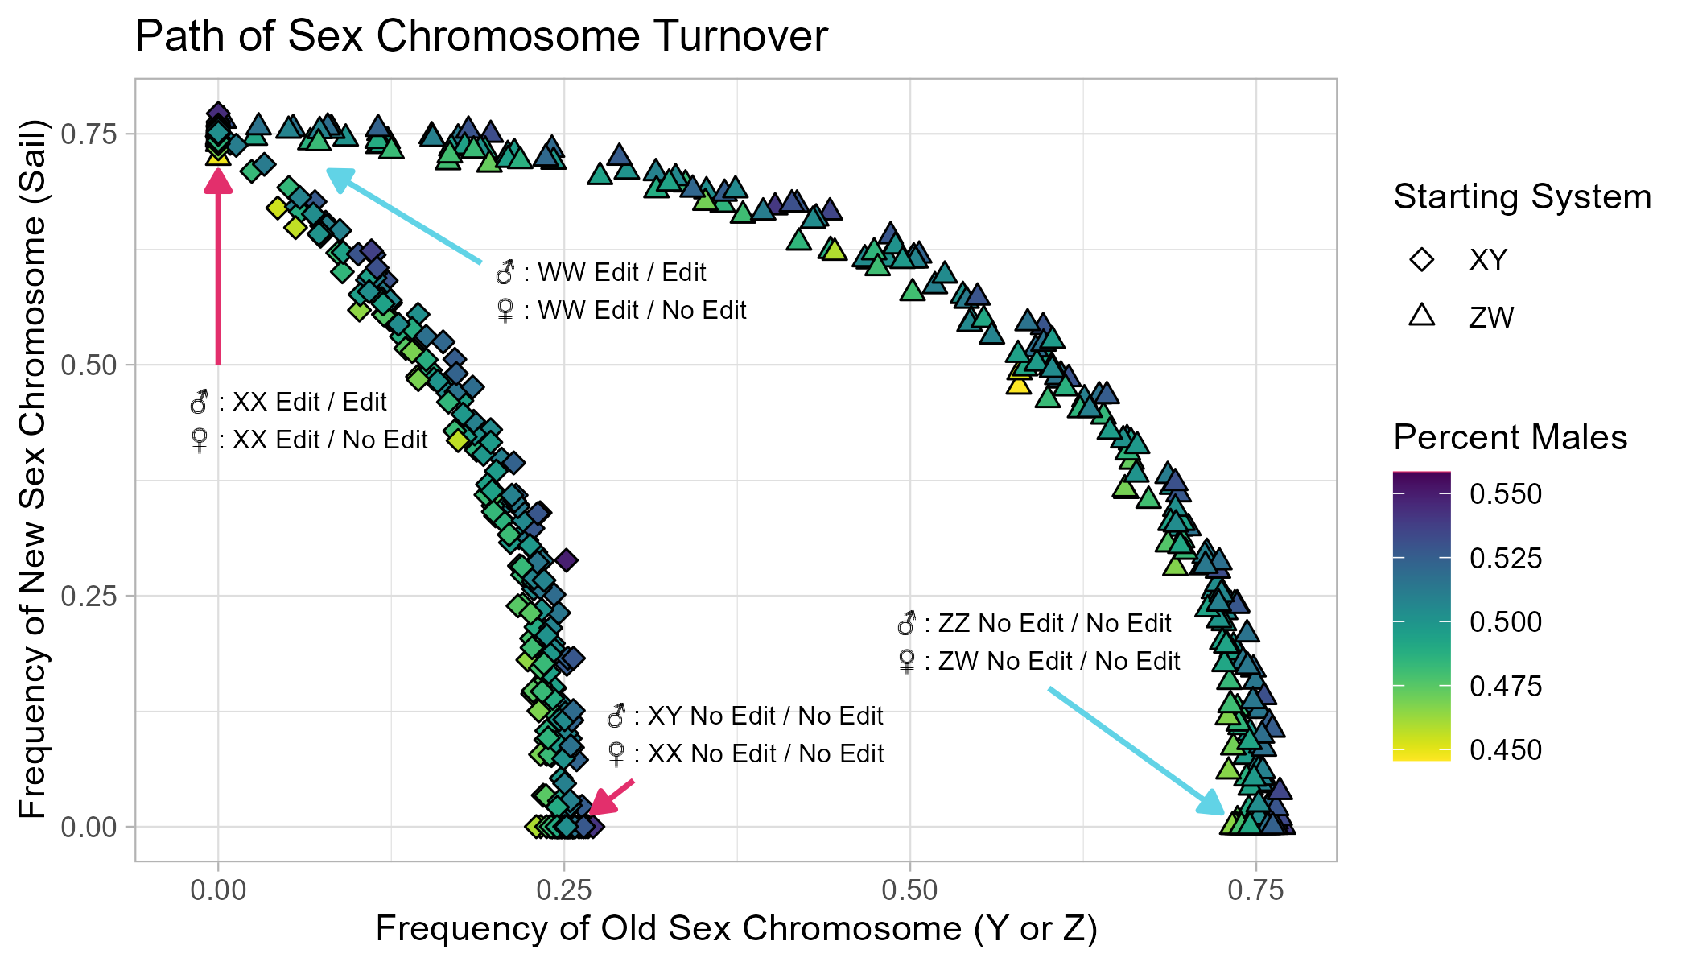

Slide 21
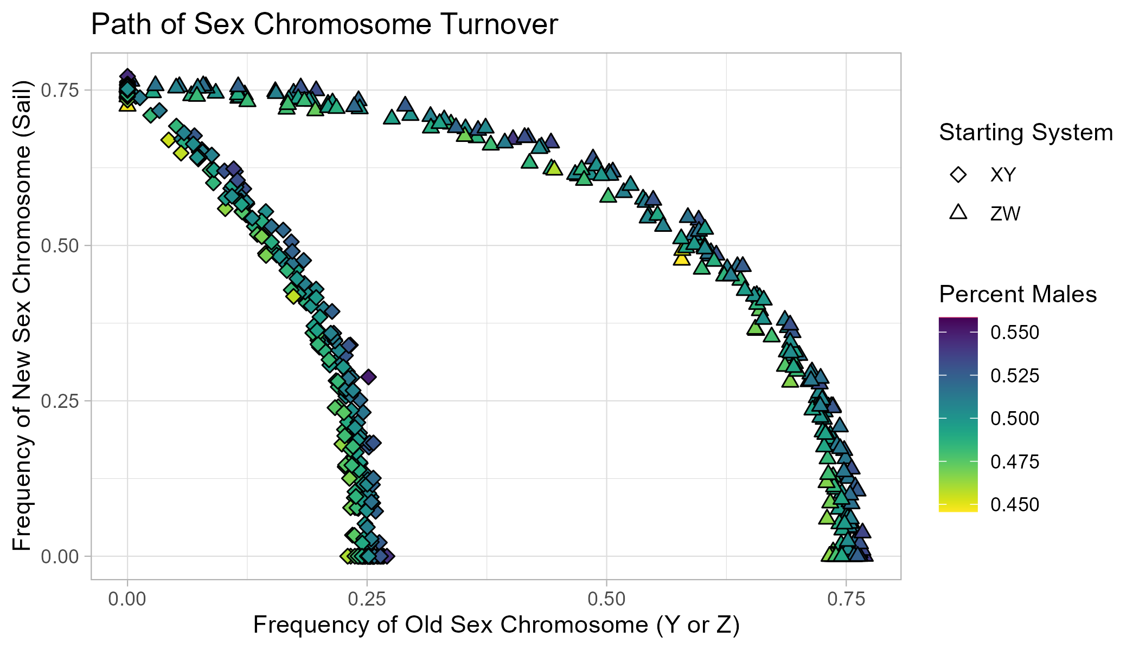
 | XX | XY
BB | ♂ | ♂︎
Bb | ♀︎ | ♂︎
bb | ♀ | ♂︎
 | WW | WZ | ZZ
BB | ♂︎ | ♂︎ | ♂︎
Bb | ♀︎ | ♀︎ | ♂︎
bb | ♀︎ | ♀︎ | ♂︎

Slide 22
A = WT Aromatase (No Edit) a = Aromatase knock-out (Edit)
 | XX | XY
aa | ♂ | ♂︎
aA | ♀︎ | ♂︎
AA | ♀ | ♂︎
 | WW | WZ | ZZ
aa | ♂︎ | ♂︎ | ♂︎
aA | ♀︎ | ♀︎ | ♂︎
AA | ♀︎ | ♀︎ | ♂︎

Slide 23
A = WT Aromatase (No Edit) a = Aromatase knock-out (Edit)
 | XX | XY
aa | ♂ | ♂︎
aA | ♀︎ | ♂︎
AA | ♀ | ♂︎
 | WW | WZ | ZZ
aa | ♂︎ | ♂︎ | ♂︎
aA | ♀︎ | ♀︎ | ♂︎
AA | ♀︎ | ♀︎ | ♂︎

Slide 24
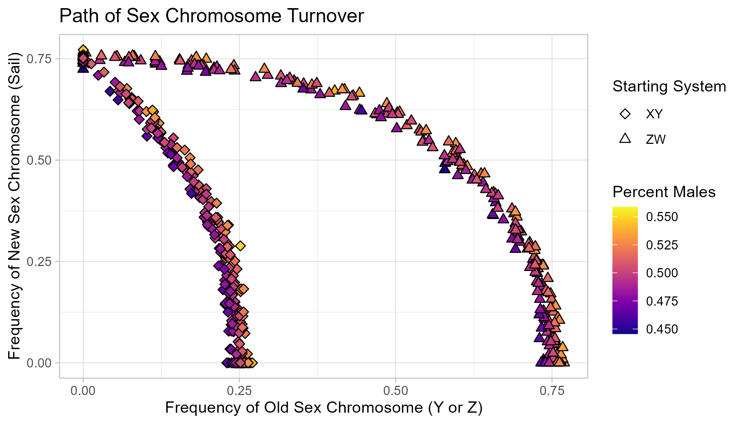
A = WT Aromatase (No Edit) a = Aromatase knock-out (Edit)
 | XX | XY
aa | ♂ | ♂︎
aA | ♀︎ | ♂︎
AA | ♀ | ♂︎
 | WW | WZ | ZZ
aa | ♂︎ | ♂︎ | ♂︎
aA | ♀︎ | ♀︎ | ♂︎
AA | ♀︎ | ♀︎ | ♂︎

Slide 25
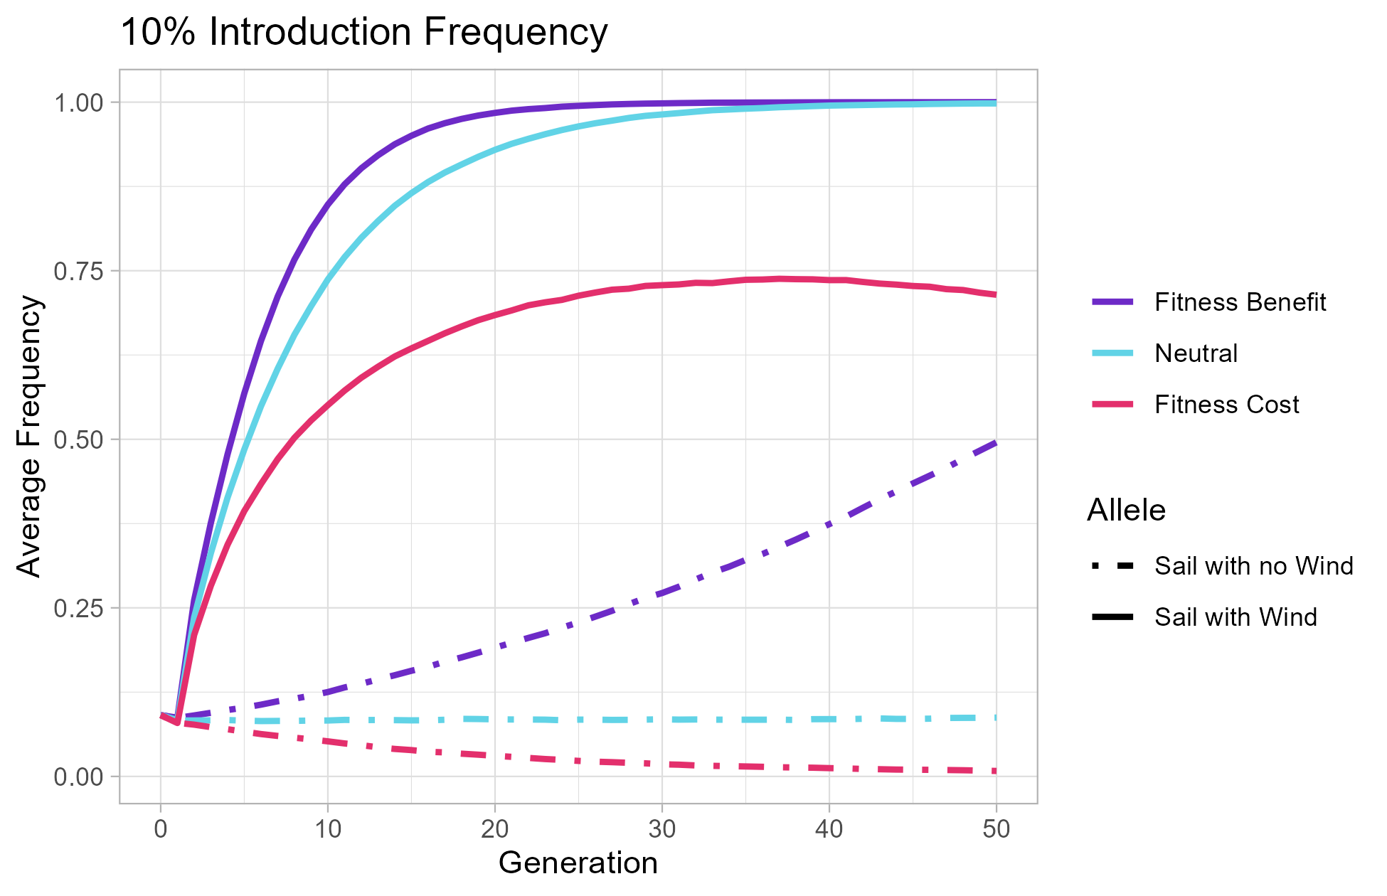
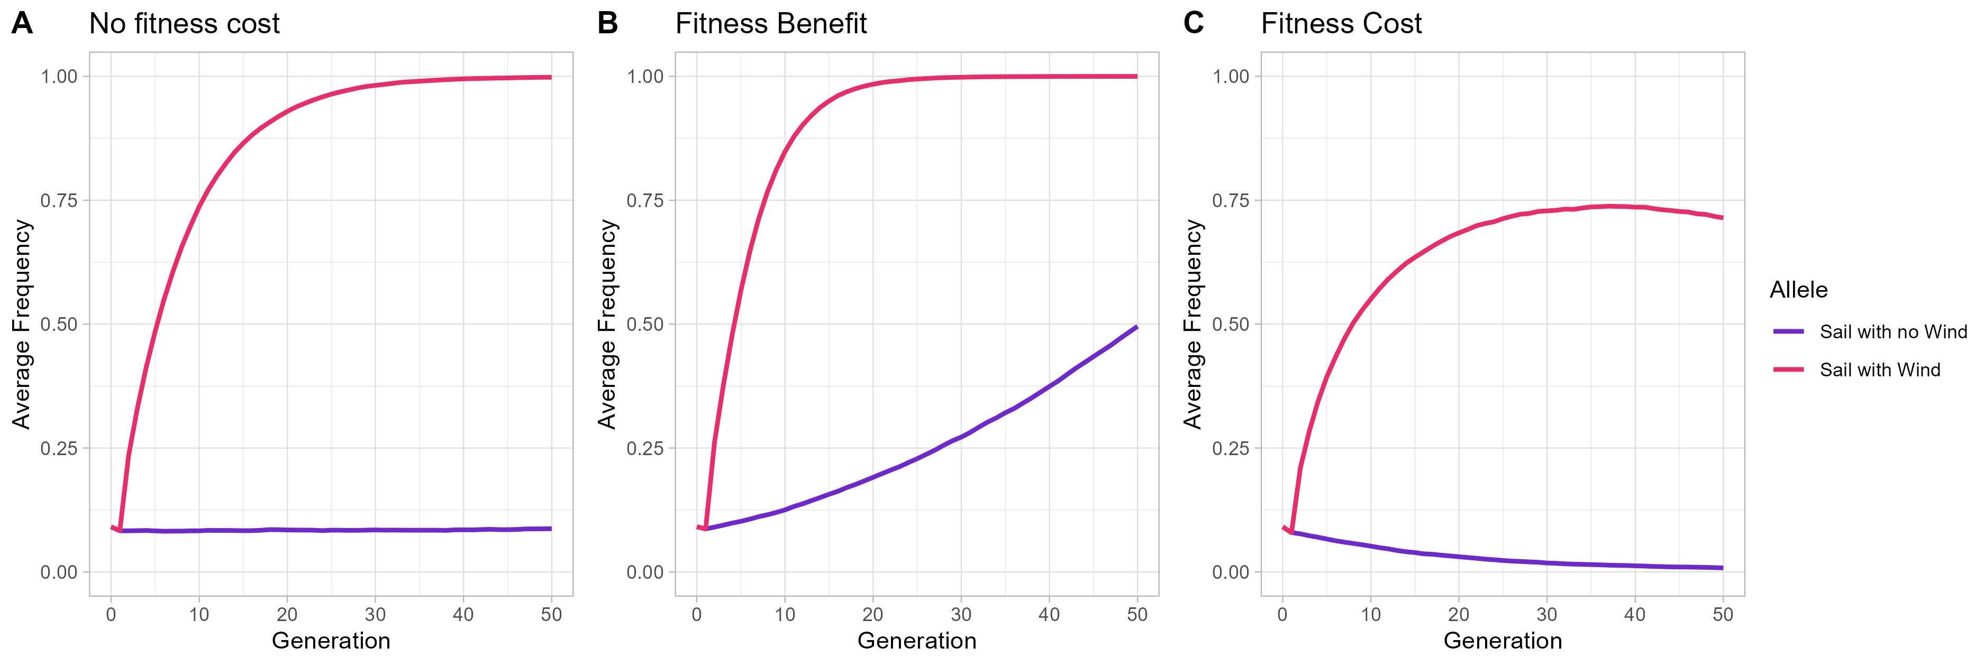

Slide 26
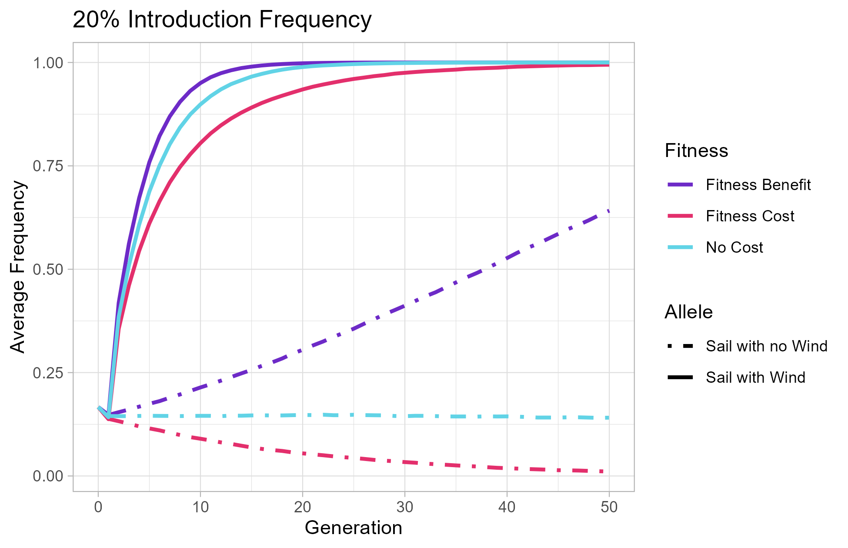
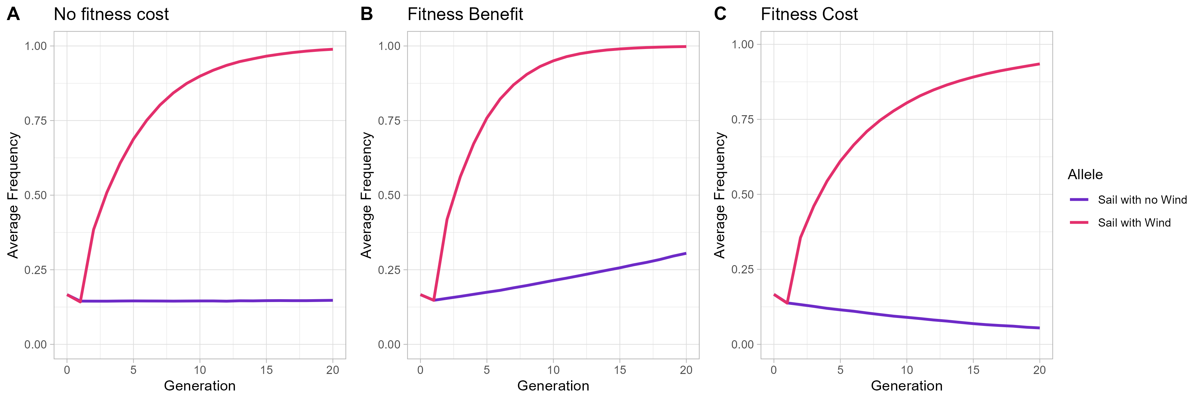

Slide 27
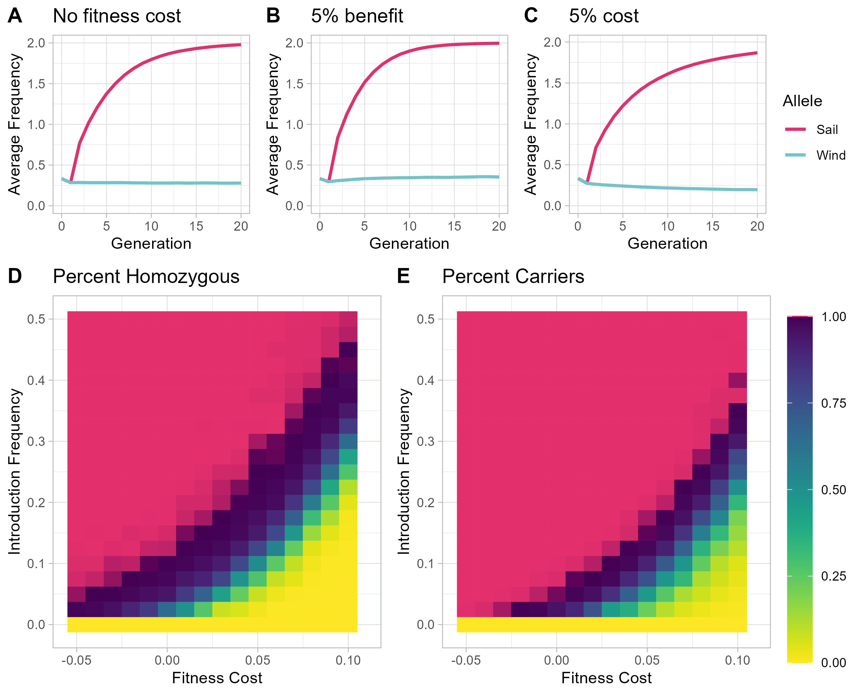
0.9992
0.996
0.467

